Slide 1
How to Promote contributorship and data sharing to cultivate research integrity via capacity building for early career academics
Dasapta Erwin Irawan
Institut Teknologi Bandung, Indonesia/
RINarxiv preprint server
Juneman Abraham
Bina Nusantara University

Slide 2
Disclaimer
Based solely from Indonesia’s experiences.
Some would relate with you and some might be local.
All sketchnotes/cartoons shared here are under CC0 license, so feel free to reuse them.

Slide 3
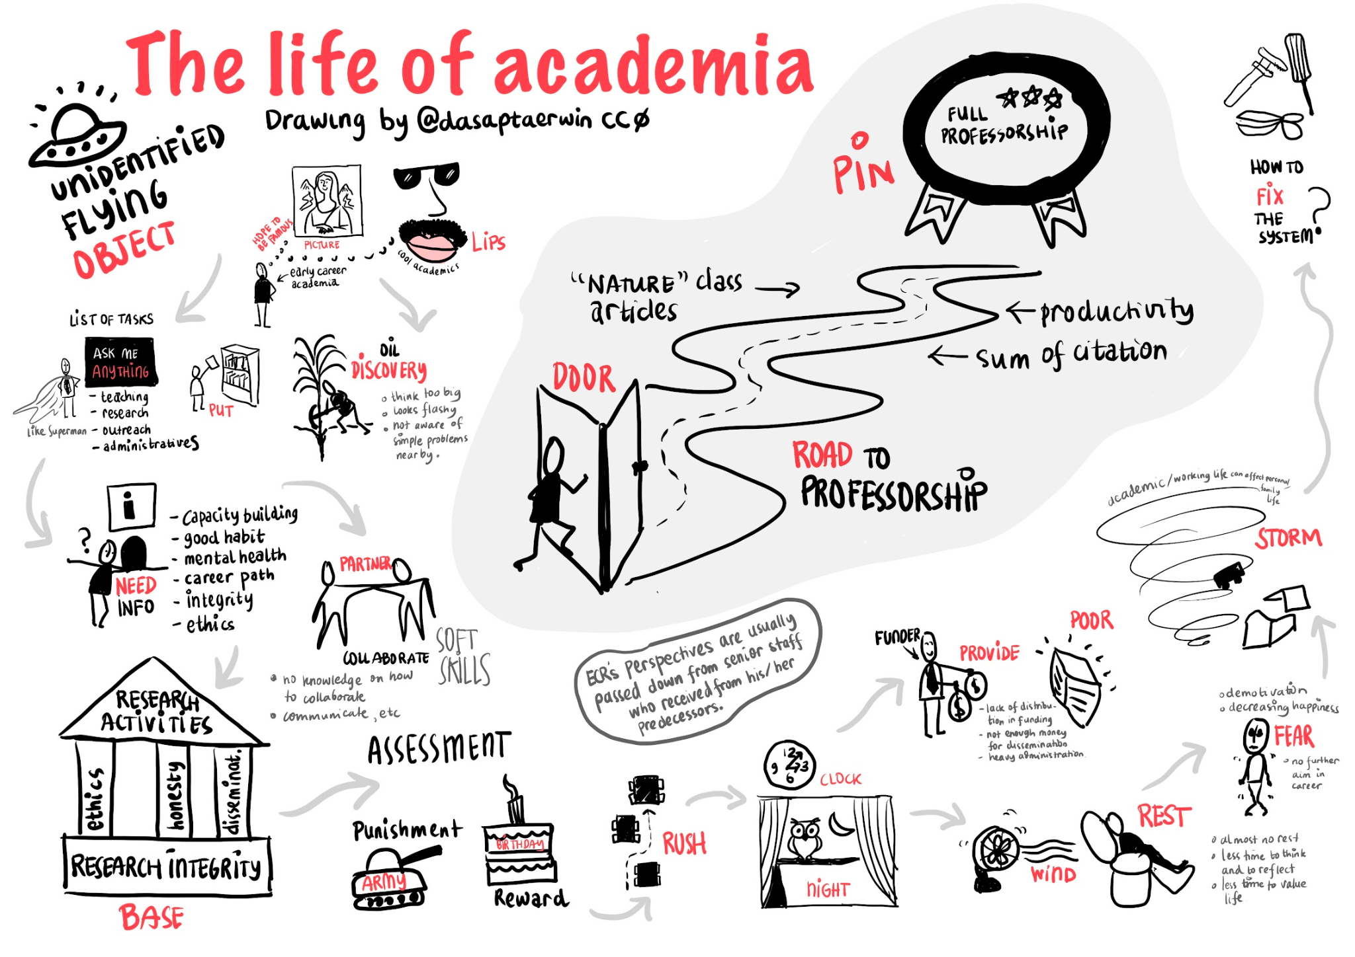
link to original file

Slide 4
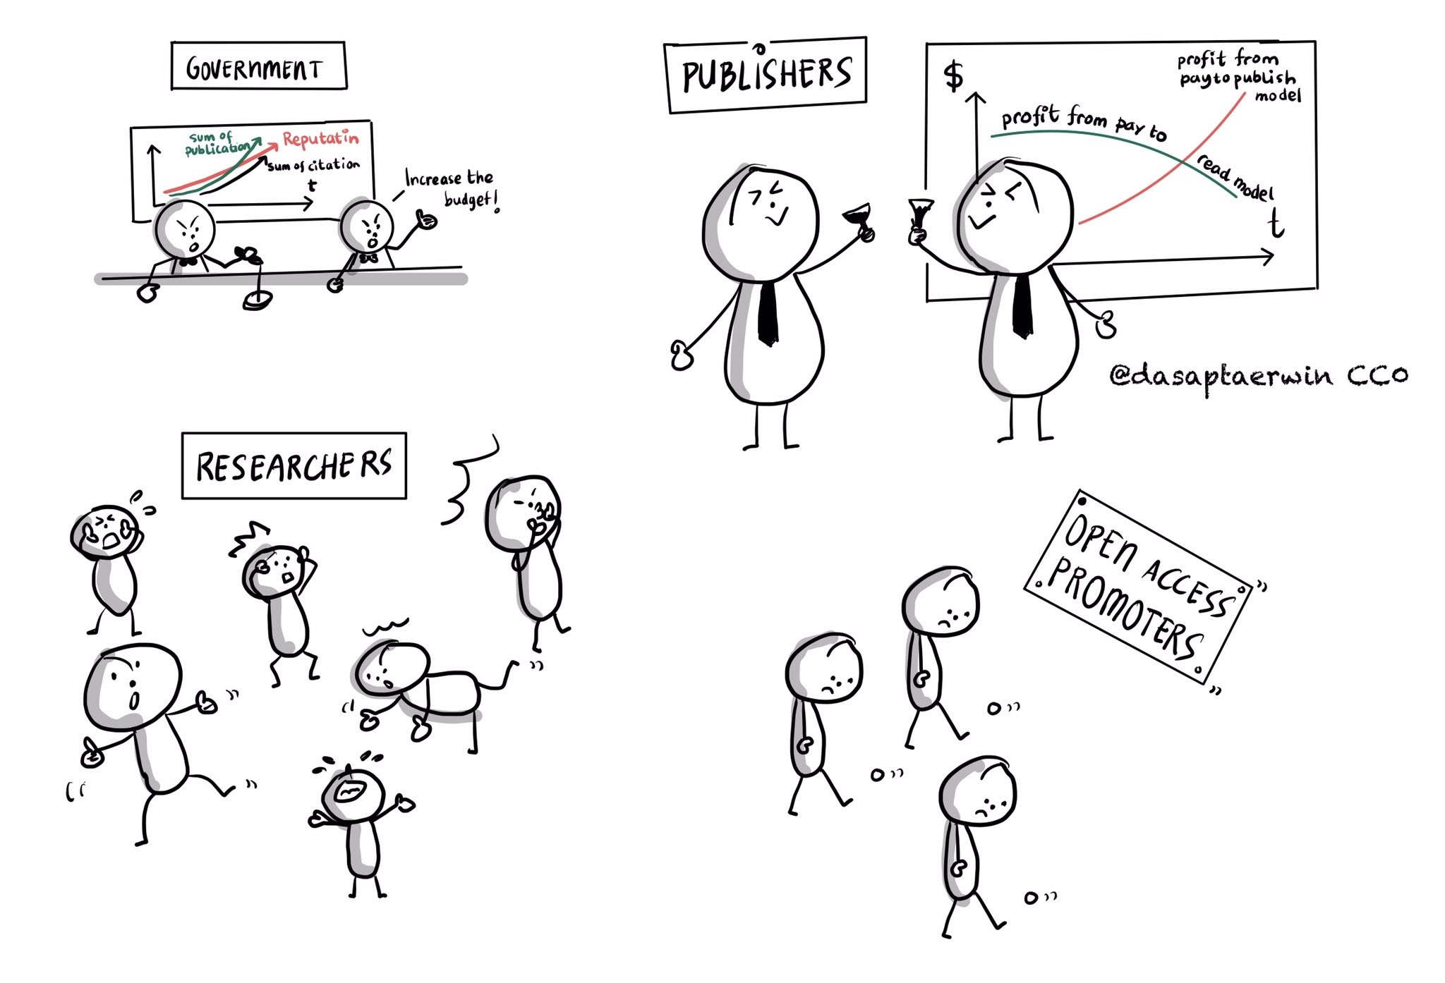
corporation
motivation
government motivation
less motivation :)
personal motivation
My sketchnote based on an article in LSE Impact Blog: https://blogs.lse.ac.uk/impactofsocialsciences/2022/08/11/article-processing-charges-apcs-and-the-new-enclosure-of-research/
link to original file

Slide 5
What we have now as early career academia
legacy
disorientation
lack of critical thinking
irrelevant perceptions on internationalization
strong dependency to brands
lack of sensitivity to the community

Slide 6
we need to
stop the legacy
realignment via capacity building
pointing out the importance of academic culture
widen the perspectives: growing international conversation

Slide 7
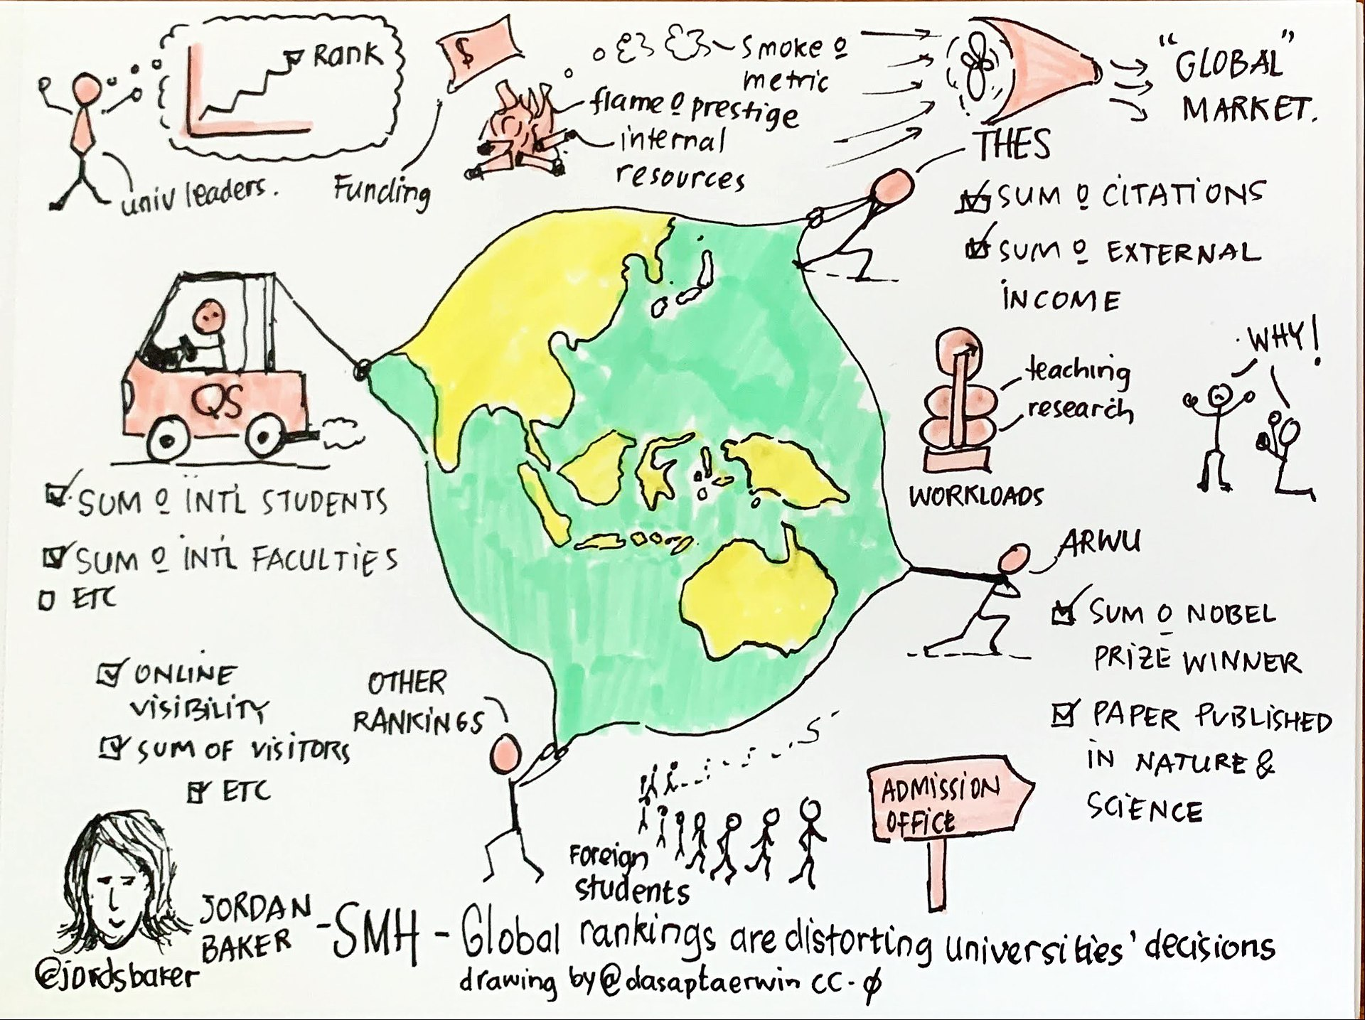
link to original file

Slide 8
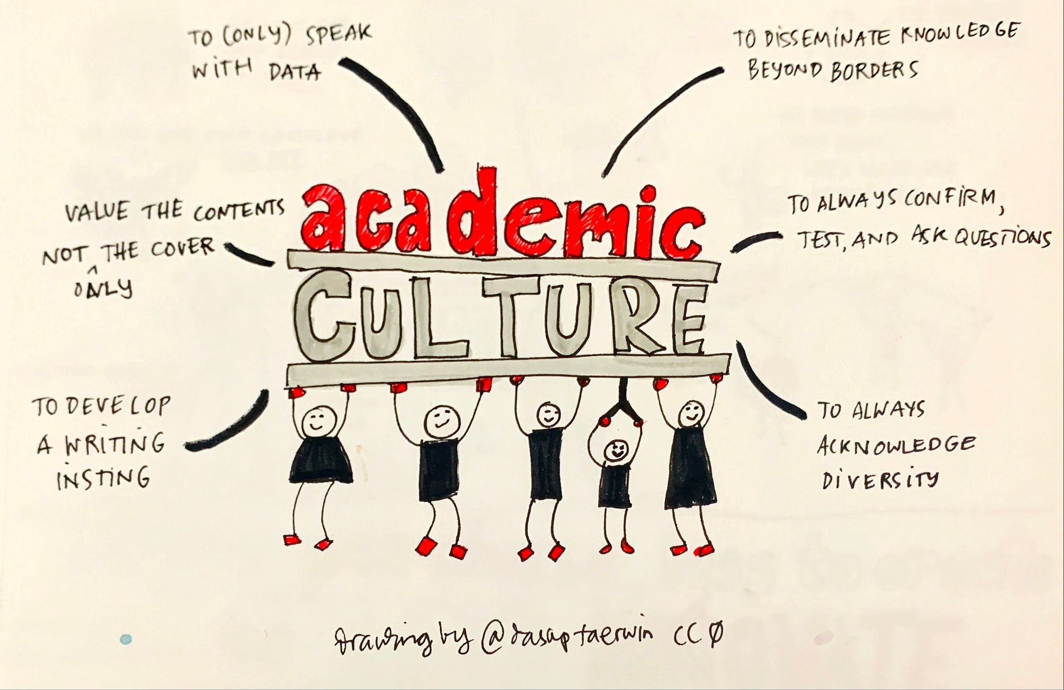
link to original file

Slide 9
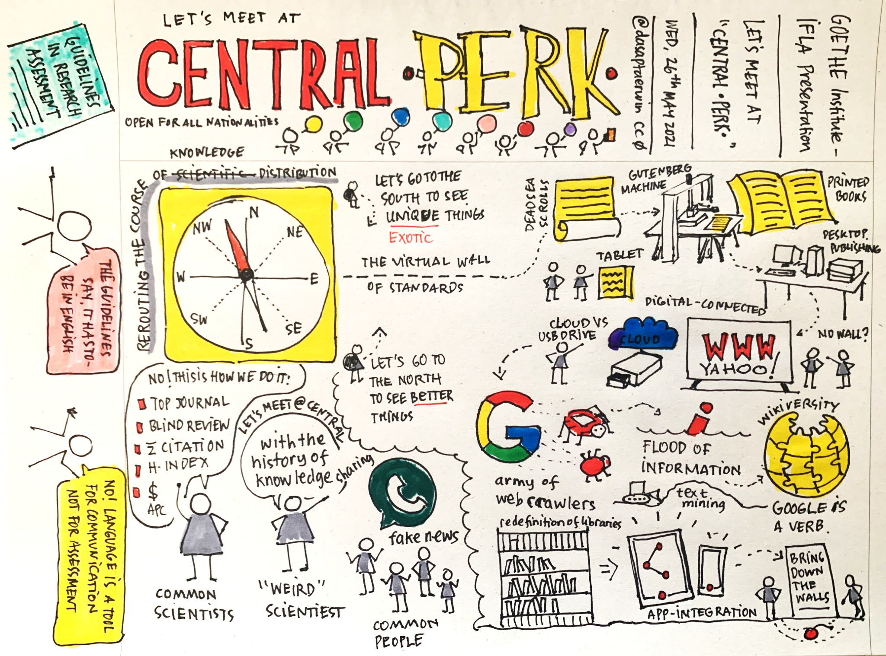
link to original file

Slide 10
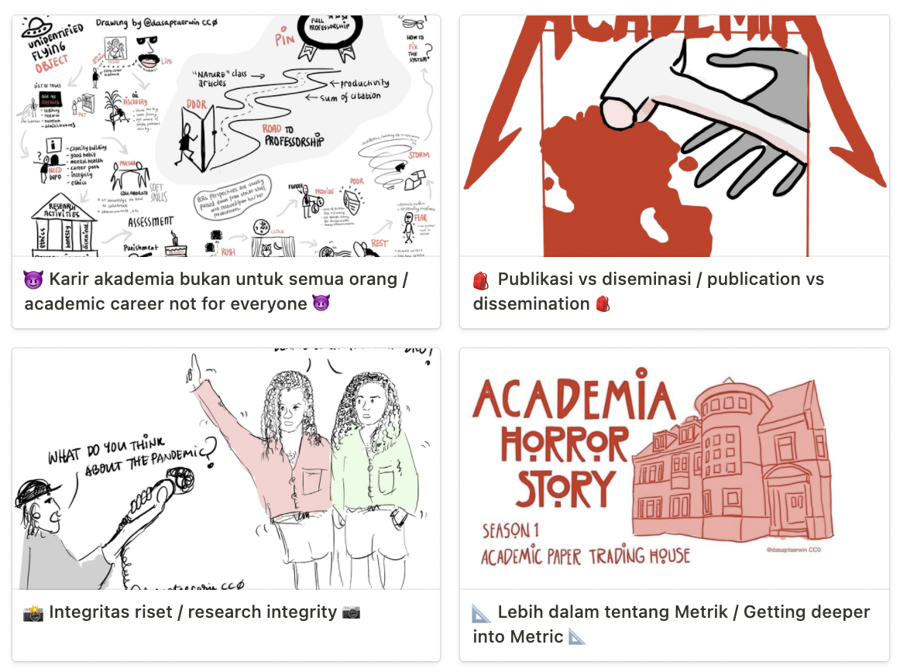
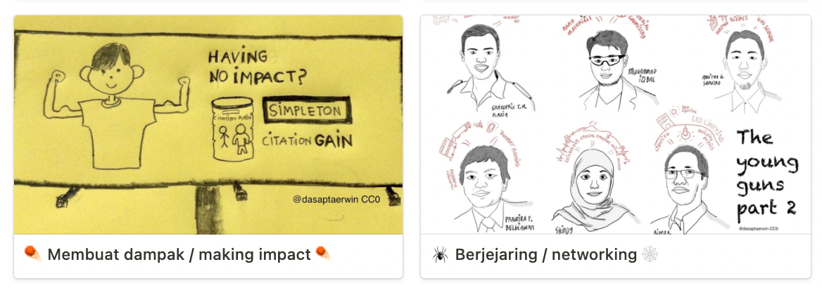
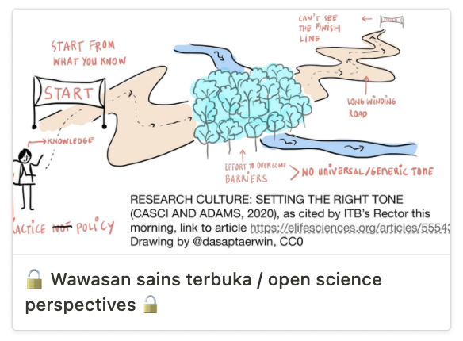
https://dasaptaerwin.notion.site/Materi-pembinaan-Dosen-Baru-914cd9356cfd4ffb8cc385fc229744e3
the syllabus

Slide 11
closing
Capacity building for early career researchers are very much needed to shift the perception of academic culture and research integrity.
Two goals are contributorship and data sharing.
We need to do this as early as possible
Aiming undergraduate students
`Grit` is needed

